Slide 1


Project Name: Proyecto de prueba Plan Number: #14
Project Number: # 14
Owner:Mauricio Balcazar Area: Marketing

Slide 2
Project Approval
OBJECTIVE: slkañsKLÑKAsmnflajnAFS
WHEN: aslkdnlaksjdlkas
DETAILS: asdaskdjalskfñnasdjnñgaskjernfñlkeNFÑa
WHERE: Nationwide
Oscar Lara
CEO México
Tony Ling
General Manager

Slide 3
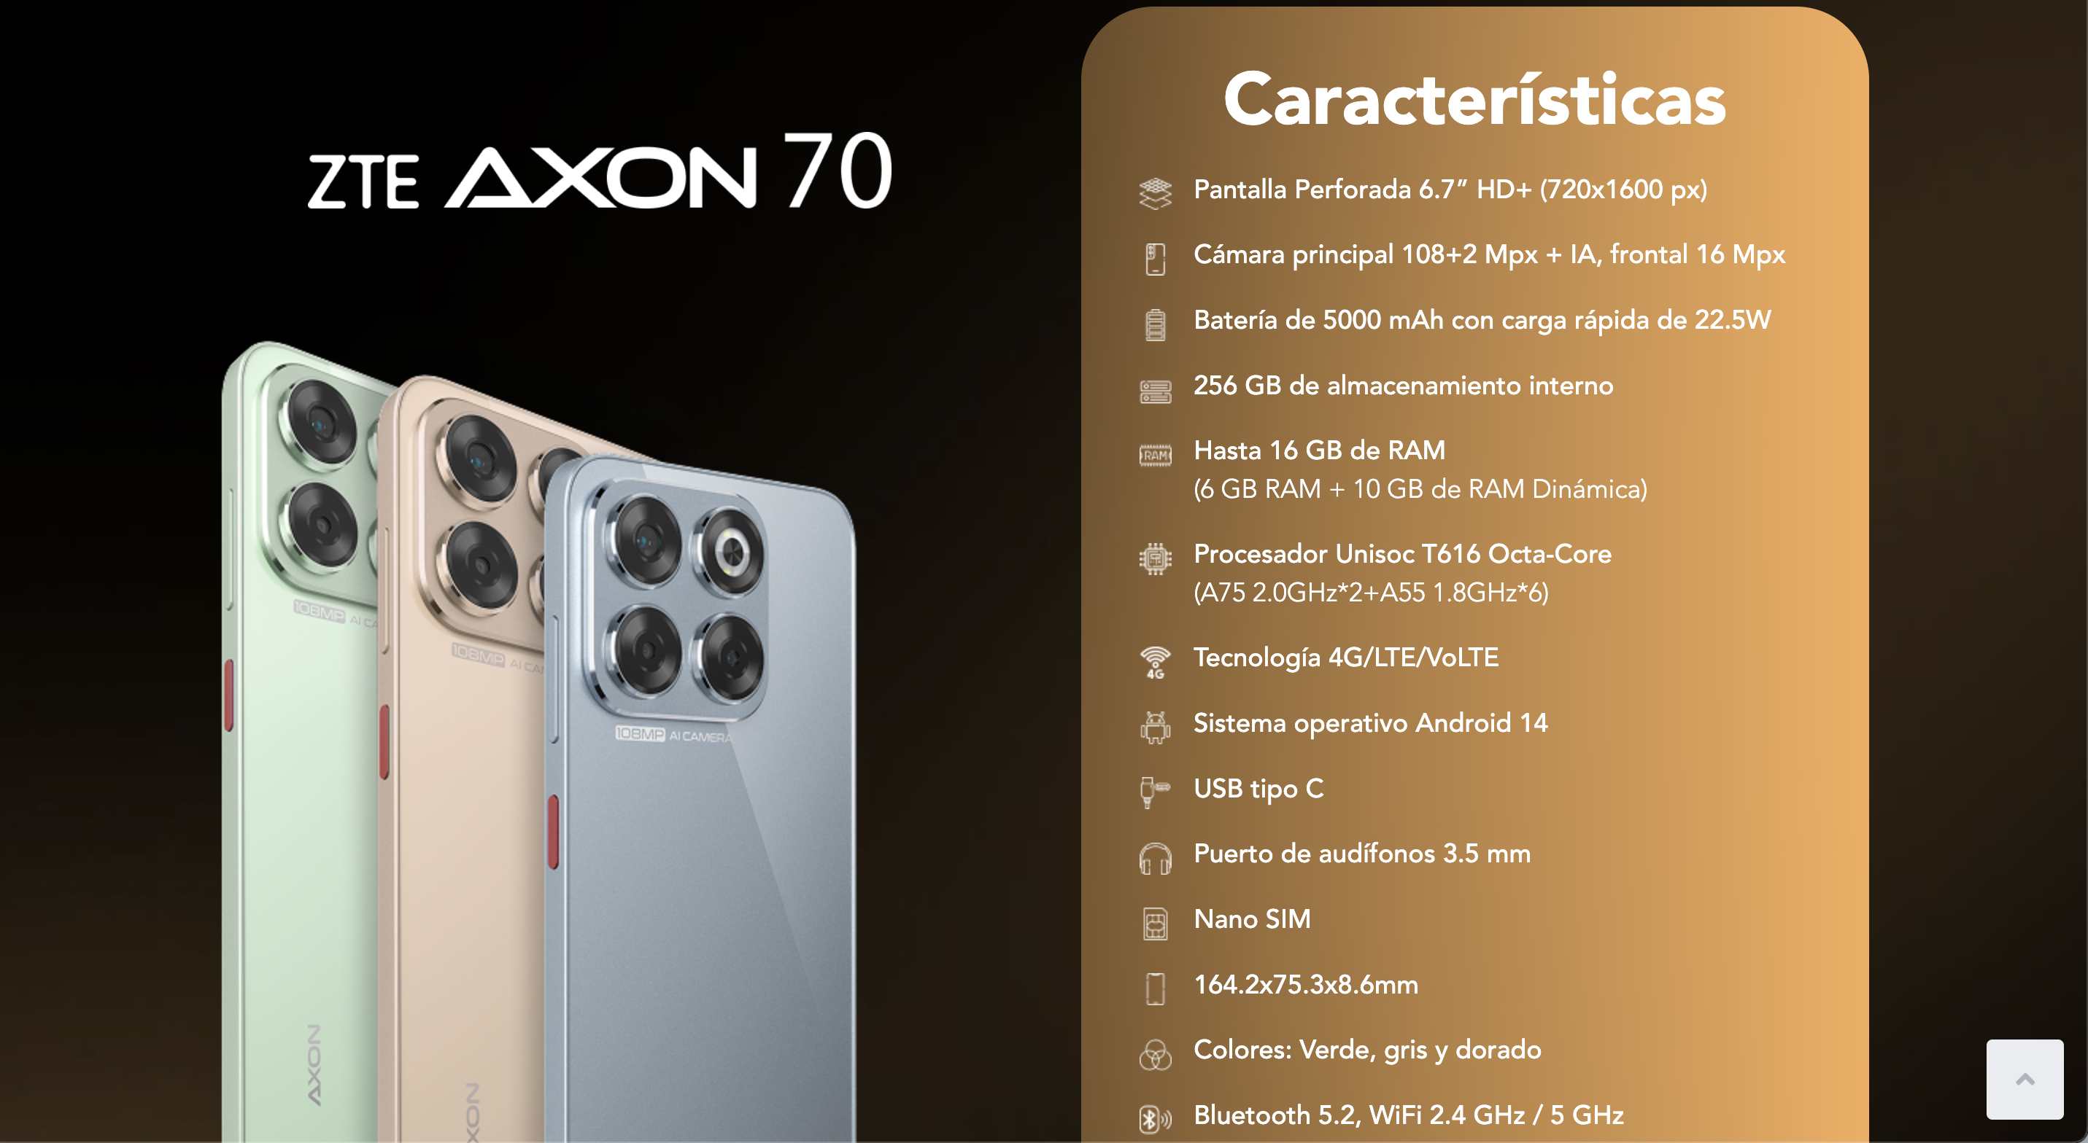
Reference images

Slide 4
PO NAME:
SUPPLIER: Wiper PLAN NUMBER: 14 DELIVERY TIME: 10 de enero 2025
DELIVERY ADDRESS: CDMX
BUDGET MXN: 150000+ TAx
BUDGET USD:10000 +TAX EXCHANGE RATE: 20.12
REQ CODE: AI2412412412 AGREEMENT CODE: asdas
Gabriela P./ Diego N.
Projects and Purchase
Li Yuhan
Project Manager
Oscar Lara
CEO Mexico
Tony Ling
General Manager

Slide 5

Requirement e-mail (purchase team)

Slide 6

First Quote:

Slide 7

Second Quote:

Slide 8
Third Quote:

Slide 9

Final Quote:
Latest quote from the selected supplier, after having achieved some improvement in delivery time or cost

Slide 10
Analysis Team: (in case of apply frame work)
Example:
NOMBRE DEL PROVEEDOR | SUPPLIER 1 | SUPPLIER 2 | SUPPLIER 3 | SUPPLIER 4 | SUPPLIER 5
评委1 CalificadorLi Yang
评委2 Calificador Zhou Shanshan
评委3 Calificador Xu Yuqing
评委4 Calificador Ouyang Jiayi
技术得分 Calificacion total tecnica
商务价(不含税) Monto total Sin IVA
报价单价(含税) Monto total con IVA incluido
商务得分 Calificacion total de parte comercial
技术权重(%) Parte tecnica
商务权重(%) Parte comercial
综合得分 Ganador

Slide 11
Comparative (in case of not applying fame work)
Example
 |  | FBI |  | Fridmay |  | Promo Piensa
Concepto | Cantidad | Unit cost | Total | Unit cost | Total | Unit cost | Total
ÍTEM
Sub Total + IVA
Tiempo de entrega
Provedor seleccionado |  | X
Justification of selected supplier:

Slide 12
Review of physical samples

